Slide 1


Automated Tomographic 4D-STEM Data Acquisition Workflow Connected with Ptychographic HR 3D Reconstruction
Shengbo You¹, Baixu Zhu², Xingchen Ye², Philipp Pelz¹
1. Institute of Micro- and Nanostructure Research, Friedrich-Alexander-Universität Erlangen-Nürnberg
2. Department of Chemistry, Indiana University Bloomington

Slide 2
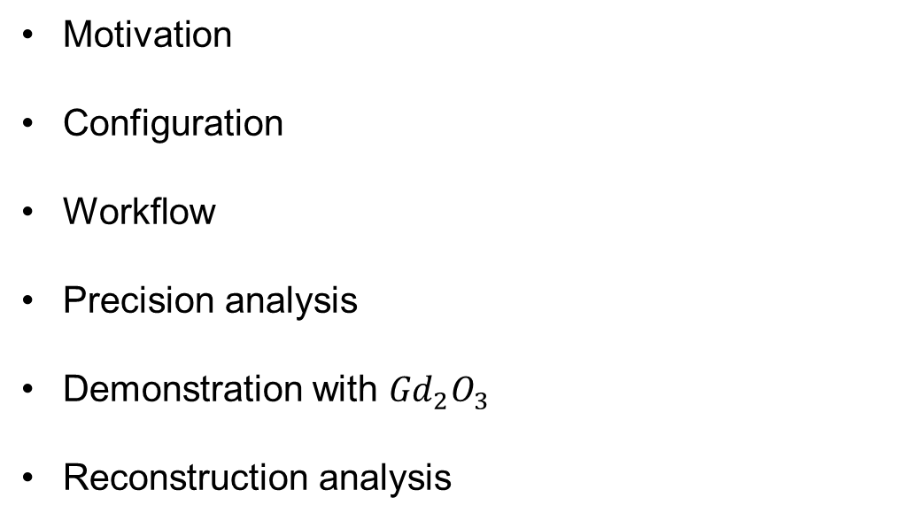
Overview
Motivation
Configuration
Workflow
Precision analysis
Demonstration with ${Gd}_{2}O_{3}$
Reconstruction analysis

Slide 3
Multi-slice ptychography achieves very high 2d resolution, but limited axial resolution
- 3D resolution can be enhanced by tilt series experiments
- We have developed Ptychographic tomography as a powerful method to achieve 3D atimc resolution phase-contrast imaging
But: requires highly trained microscopist & long experiments

Slide 4
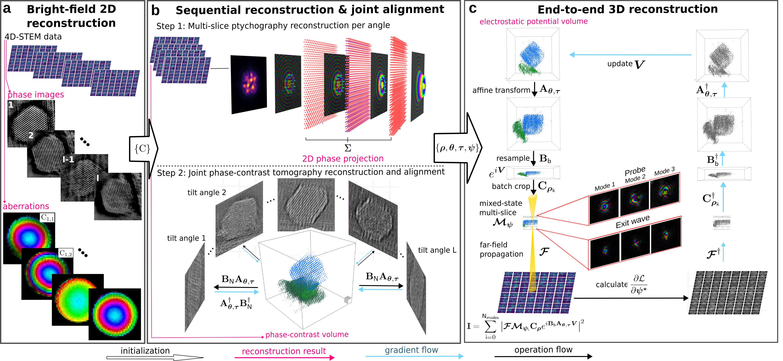
End to end reconstruction workflow
Recover the 3D structure of the sample directly from the 4D STEM data
You et al., Phys. Scr., 2024, 100, 015404.

Slide 5
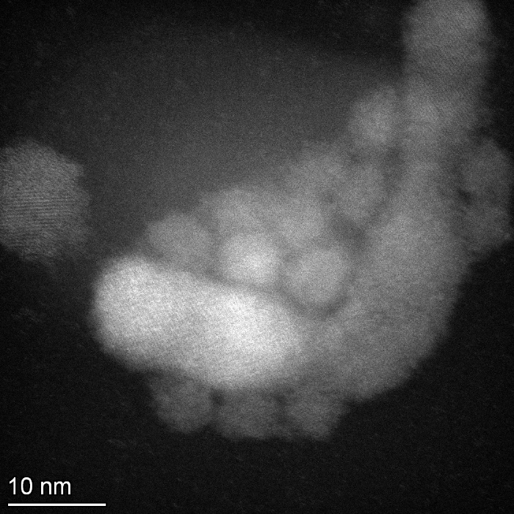
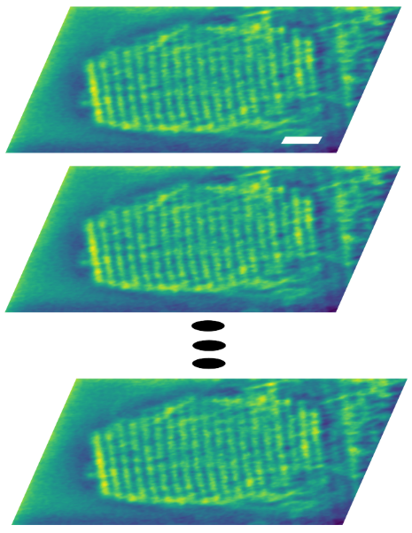
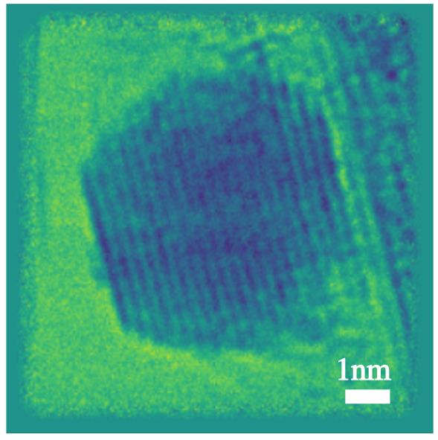
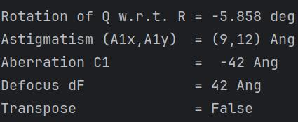
Motivation
Dose efficiency: nearly all electrons that pass through the target area are contributing as data.
Hands-free expertise: achieve atomic resolution level data acquisition without well trained operator.
Real time feedback: check the data quality immediately after acquisition.
Carbon accumulation
Multislice
Phase projection
Aberration
Our goal: automated tomographic 4D STEM data acquisition achieving atomic resolution

Slide 6

Synchronised scan signal & trigger
End to end
reconstruction
Scan Controller
Image/data request
Affine
transformation
HAADF image
HAADF
image
Alignment
Scan coil
HAADF image
Scan API
2D phase projection
Multislice ptychography
Sample
TEM scripting
interface
4D-STEM
Camera Plugin
SerialEM
Image/data
request
Image/data
request
Defocus
SerialEM
command
Parallax
HAADF
detector
HAADF signal
Custom Scripts
High performance
Workstation
Microscope PC
Arina Detector
4D STEM raw data
Detector control PC
4D STEM compressed data
Custom script control TEM to perform the data acquisition. Data is reconstructed in real time

Slide 7
Workflow
Initial degree
Ground truth at log mag (57k)
Ground truth of reference region
Record the data
Tilt to the next angle
Fine alignment at reference area
Course alignment at low mag (57k)
Take image at reference region
Calculate the defocus and offset
Two level of alignment to ensure fine tracking of the target area

Slide 8
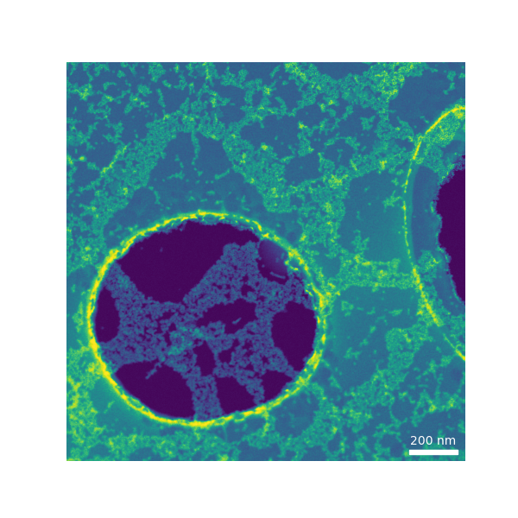
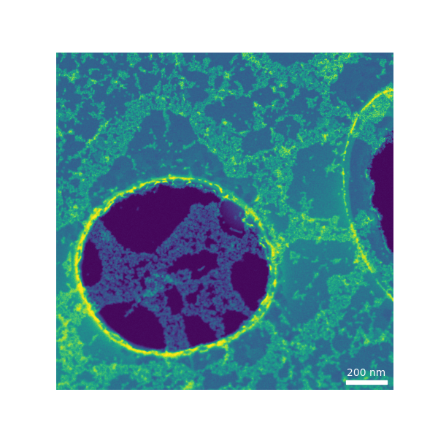


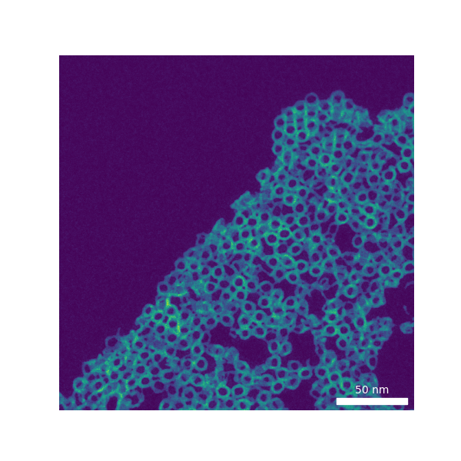
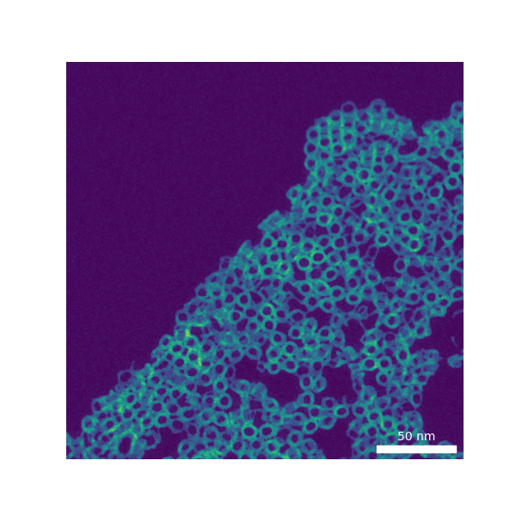

Workflow demonstration
Course alignment (low mag)
Fine alignment (reference area)
data acquisition
5nm
Nearly all electrons went through the target area are contributing as data

Slide 9
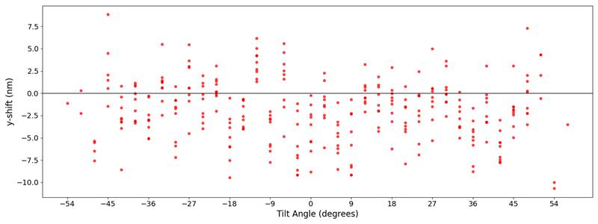
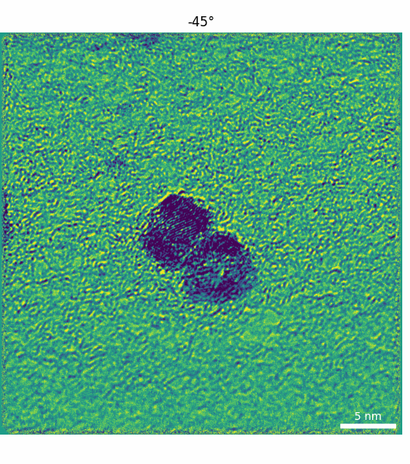
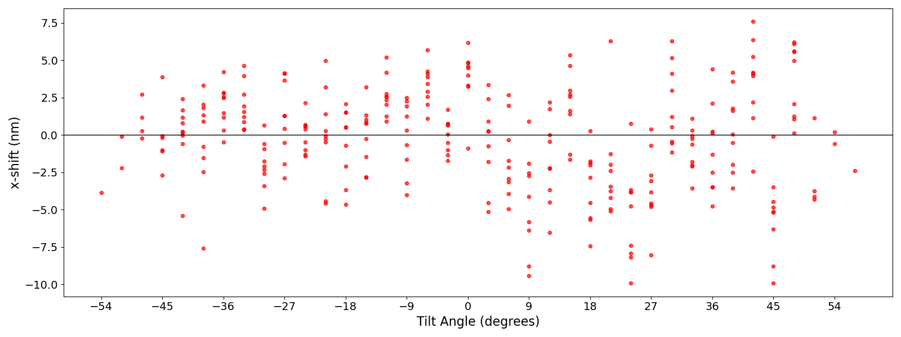
High-precision automated tracking
Data collection at target area
± 10 nm tracking error through the tilt series

Slide 10
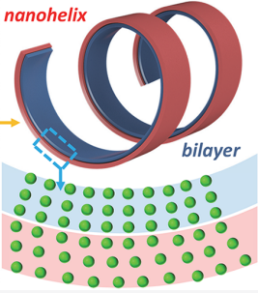
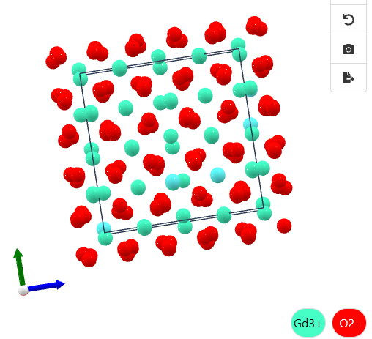
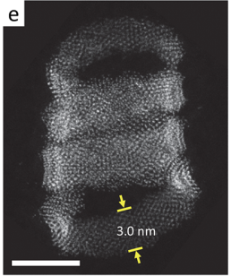
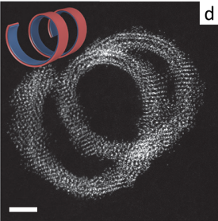
Sample: ${Gd}_{2}O_{3}$
5nm
Liu et al., J. Am. Chem. Soc., 2020, 142, 12777–12783.
2nm
Gd₂O₃ nanohelices formed via bilayer lattice misfit strain.

Slide 11
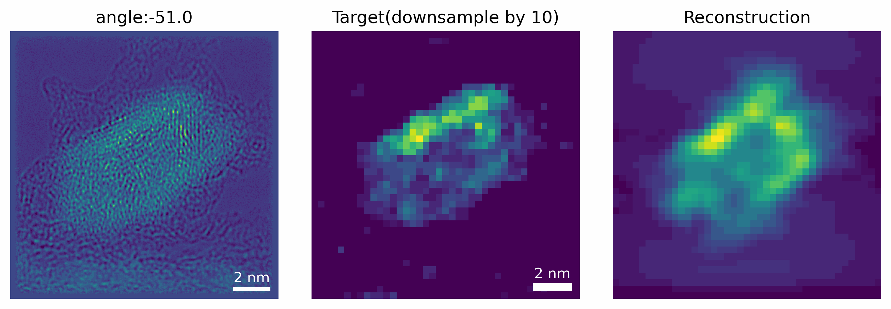
Multislice and linear tomography
Projection of each angle
Multislice ptychography reconstruction show atomic resolution in 2D

Slide 12
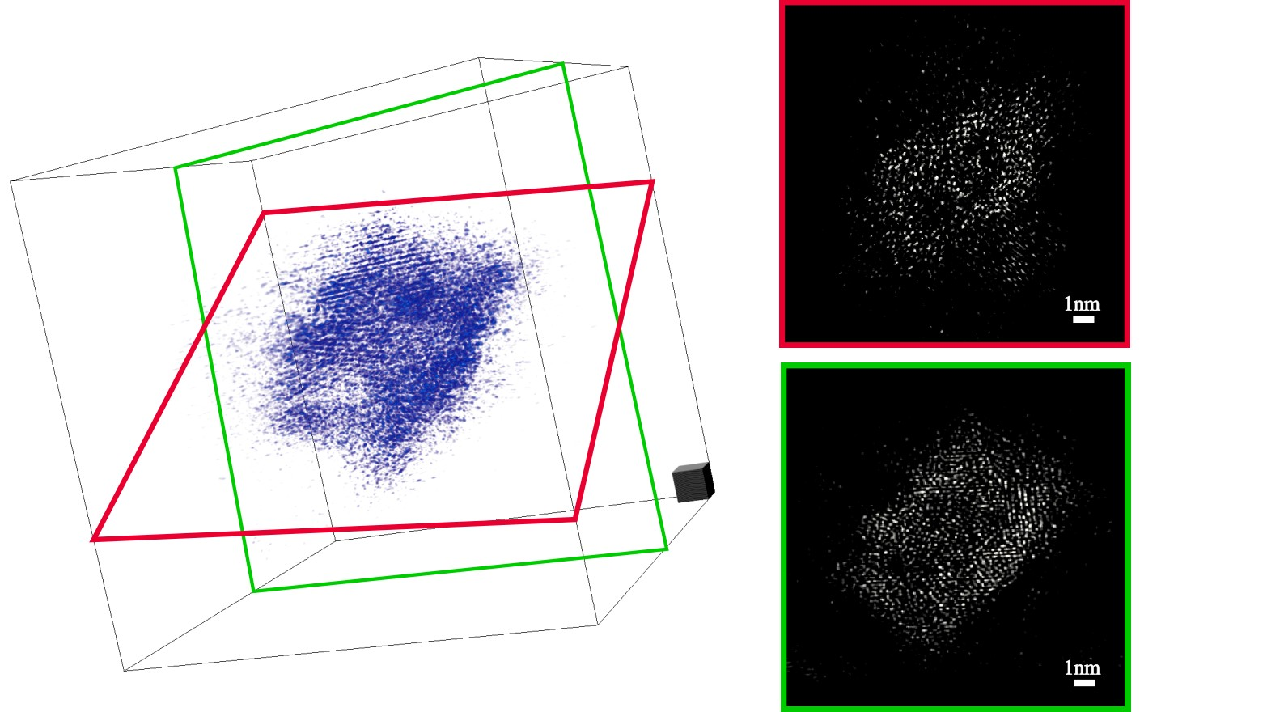
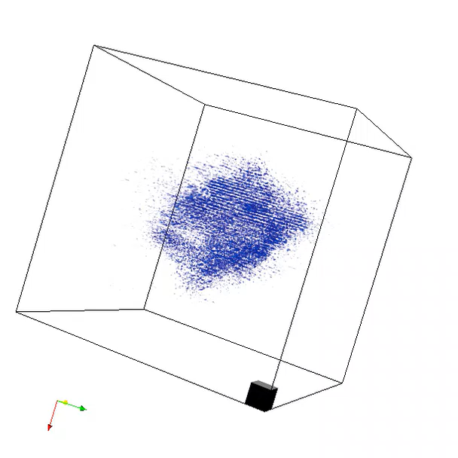
End to end reconstruction
Cross-section
Reconstructed 3D volume
1nm³
End to end reconstruction show atomic resolution in 3D

Slide 13
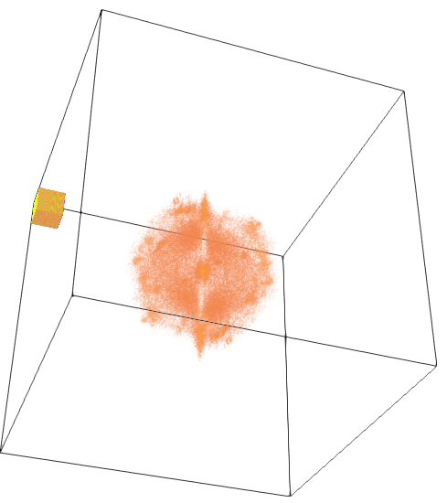
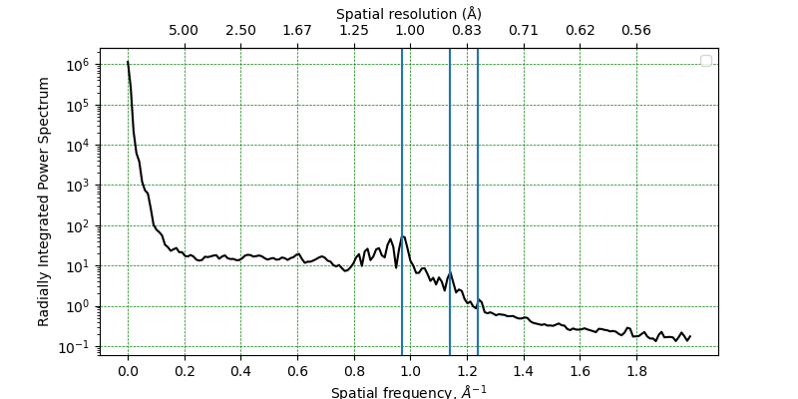
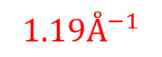
Result analysis
Reconstructed volume in Fourier domain
1.05Å
0.88Å
0.81Å
$$1.19Å^{−1}$$
Sub- Ångstrom 3D resolution

Slide 14
conclusion
Tomographic 4D STEM with high dose efficiency
Atomic resolution data acquisition without well-trained operator
Less than 10nm error
Sub-(Å)ngstrom 3D resolution

Slide 15




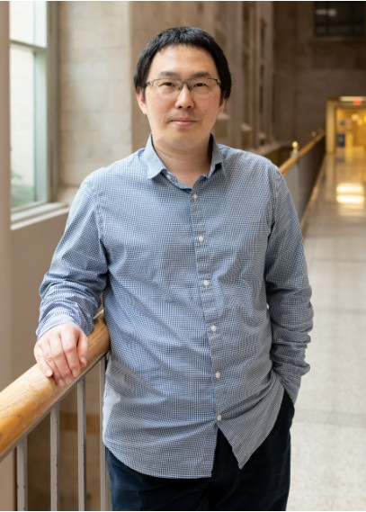





Acknowledge
Sample preparation
Supervision
Hardware support
Indiana University Bloomington
Friedrich-Alexander-Universität Erlangen-Nürnberg
Baixu Zhu
Prof. Xingchen Ye
Prof. Dr. Philipp Pelz
Matthias Meffert

